Slide 1


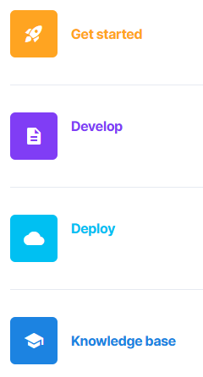
Advanced Data Analytics
Instructor: Chris Santo
Using Streamlit and Python for Advanced Data Analytics
Wednesday 6/3/2026

Slide 2
Goal
We will explore the Streamlit app framework in Python to develop interactive data apps.

Slide 3

Streamlit
Streamlit is an open-source app development framework that enables python developers to create full-featured and performant applications and primary "data apps" quickly, with only a few lines of code.
Used by over 90% of Fortune 50 companies.
For more information:
https://streamlit.io/

Slide 4
Streamlit – Playground Lab
Let's first take a look at a web-based playground
Access: (Instructor to Demo)
https://streamlit.io/playground

Slide 5
Streamlit – App Deployment
Streamlit apps are relatively easy to get going.
How do apps get deployed so they can be run by yourself and others? Here are a few deployment methods:
Local Computer from Anaconda/another Python environment Run apps from your browser using a localhost URL
Streamlit Community Cloud public apps, totally free, needs a GitHub acct Run apps from your browser, but can't restrict usage
Snowflake enterprise-grade reliability and security, costs $$
Colab Notebook uses a tunnelling technique (which is IMHO awkward) Requires no local installation and works from a browser

Slide 6

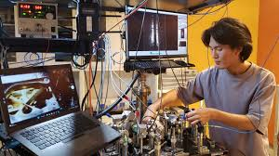
Warning: Experimental
I've never run these labs in a classroom. This is an experiment, so our results may vary. Please be kind on my surveys ☺

Slide 7
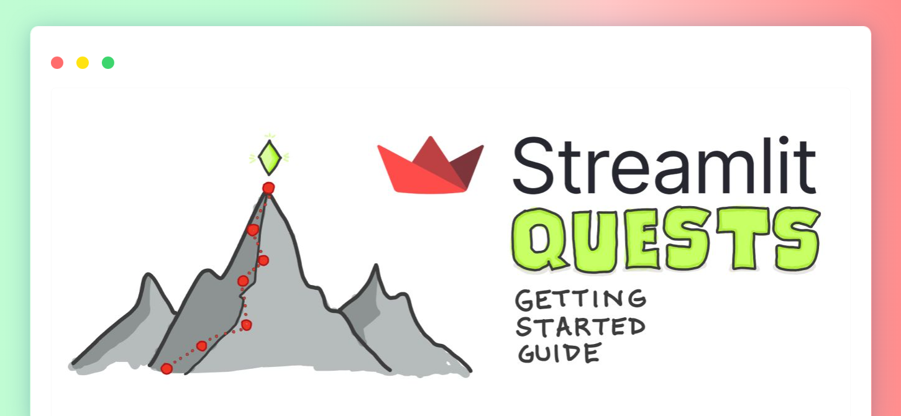
Warning: Experimental
I've never run these labs in a classroom. This is an experiment, so our results may vary. Please be kind on my surveys ☺

Slide 8
Streamlit – Hello World in Colab
Our first Streamlit lab will be run in the Google Colab environment.
Goals:
We will set up an IP "tunnel" to Colab so we can access our streamlit app.
We will create a "Hello World" app in streamlit and deploy it.

Slide 9
Streamlit – Hello World in Colab
Lab Walkthrough Steps:
Create a new Google Colab notebook and call it "Streamlit Hello World" at https://colab.research.google.com
o, *World!* :sunglasses:')

Slide 10
Streamlit – Hello World in Colab
Steps: 2. Enter the code that follows in 5 separate cells: (Cell #1) !pip install -q streamlit

Slide 11
Streamlit – Hello World in Colab
Steps: 3. Enter the code that follows in 5 separate cells: (Cell #2) %%writefile app.py
import streamlit as st
st.write('Hello, *World!* :sunglasses:')

Slide 12
Streamlit – Hello World in Colab
Steps: 4. Enter the code that follows in 5 separate cells: (Cell #3) !npm install localtunnel

Slide 13
Streamlit – Hello World in Colab
Steps: 5. Enter the code that follows in 5 separate cells: (Cell #4) !streamlit run app.py &>/content/logs.txt & curl ipv4.icanhazip.com

Slide 14
Streamlit – Hello World in Colab
Steps: 6. Enter the code that follows in 5 separate cells: (Cell #5) !npx localtunnel --port 8501

Slide 15
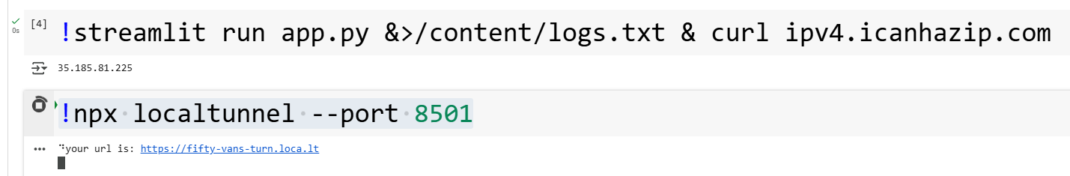
Streamlit – Hello World in Colab
Steps: 7. Run all cells in the notebook. Assuming there are no errors in any cells, you should see an IP address in the output of the 4th cell and a URL in the output of the 5th cell (An example is shown below—yours will be different)

Slide 16
Streamlit – Hello World in Colab
Steps: 8. Click on the URL link in the output of cell 5. The webpage will ask for a password. The password is the IP address output in cell 4.
Copy/Paste the IP address from the output in cell 4 from the notebook to the password page and "click to submit"

Slide 17
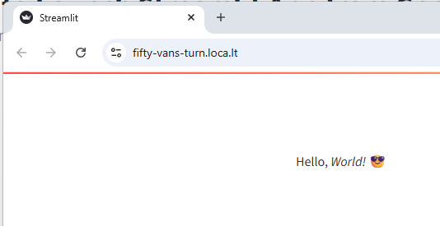
Streamlit – Hello World in Colab
Steps: 9. If everything works correctly, you should now see the output from your hello world app in the browser.

Slide 18
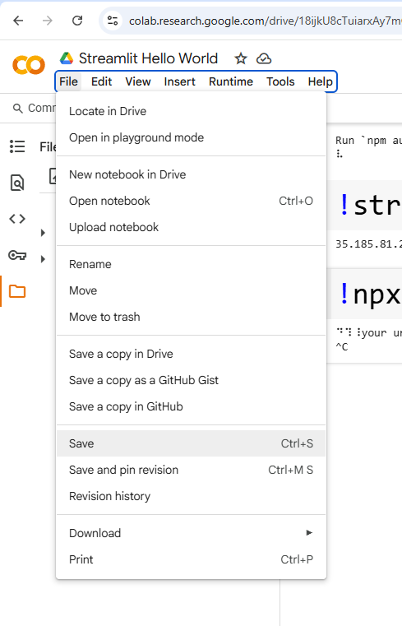
Streamlit – Hello World
Steps: 10. Save your Colab Notebook in your Google Drive. By default, the notebooks are saved in a folder called "Colab Notebooks"

Slide 19

Streamlit – Hello World Lab
Reflections – Comments – Questions?

Slide 20
Streamlit – Resources
Streamlit Crash Course: From Zero to Data App (25 min) https://www.youtube.com/watch?v=d7fnzDQ5qM8
Streamlit Quests: Getting Started with Streamlit https://discuss.streamlit.io/t/streamlit-quests-getting-started-with-streamlit/33534

Slide 21

End

